Slide 1
The solar system
Year 7 Science

Slide 2
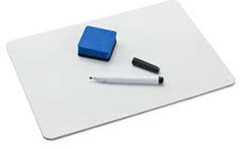
True or false?
The sun makes up 99.86% of the solar systems mass.
Just a pinhead of the sun’s raw materials could kill someone from 100 000 km away.
The length of a year on Pluto is 248 Earth years.
Olympus Mons is the largest volcano in the solar system, at 27 km high.
The light we see today started out in the core of the sun 30 years ago, it takes 8 years to reach us once it leaves the sun.
Some rocks on Earth are actually pieces of Mars.

Slide 3
True or false?
Saturn has such low density, that it would float in water.
The Atlantic ocean is expanding by 3km each year.
Uranus’ axis is at 97 degrees, which means it orbits on its side, like a rolling barrel.
Venus and Uranus rotate opposite to the direction of their orbit.
Jupiter has the shortest day of all planets, rotating once every 9 hours and 55 minutes.
Pluto is no longer recognised as a planet, except in the state of California.

Slide 4
Learning Intentions
Predictable phenomena on Earth, including seasons and eclipses, are caused by the relative positions of the Sun, Earth and the Moon.

Slide 5
Success criteria
Define and list terrestrial planets.
Define and list gas giants.
Define and list ice giants.
Compare the rotation and revolution (orbits) of the sun, planets, moons and asteroids.

Slide 6
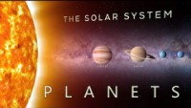

Slide 7
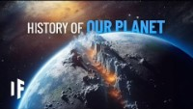

Slide 8
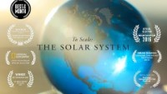

Slide 9
Success criteria
Define and list terrestrial planets.
Define and list gas giants.
Define and list ice giants.
Compare the rotation and revolution (orbits) of the sun, planets, moons and asteroids.

